Slide 1
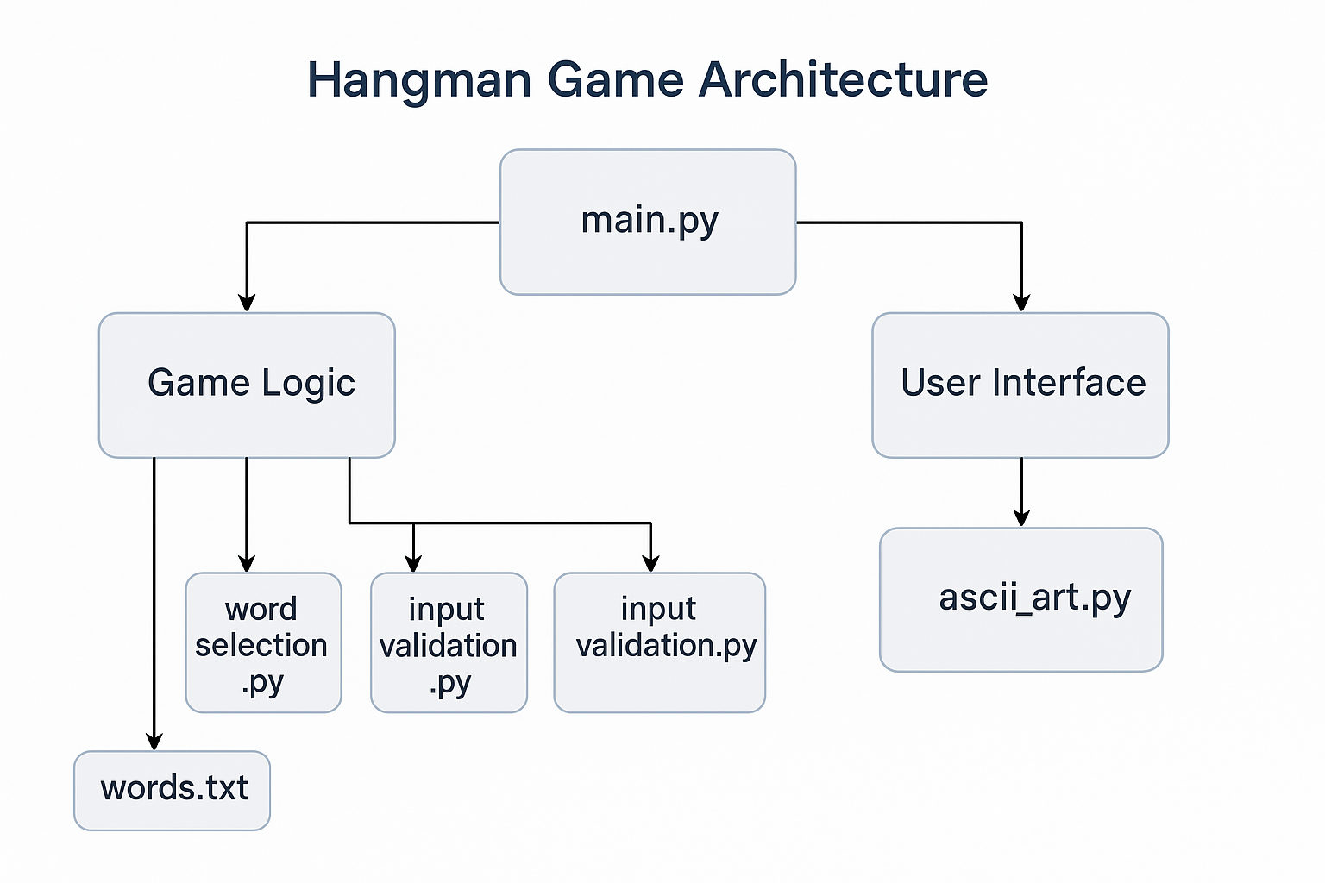
Hangman Game Architecture

Slide 2
Functions for word selection module
Def parse_word

Slide 3
Architectural Description
main.py as the entry point
Centralizes execution logic, coordinating game flow, imports, and function calls.
Keeps game setup and control distinct from implementation details.
Modular separation of concerns
word_selection.py: Manages loading and selecting words from words.txt.
input_validation.py: Handles all input checking (e.g., valid letter, duplicates).
ascii_art.py: Encapsulates all ASCII drawing logic for user feedback (e.g., hangman stages).
Game Logic module
Core functionality such as tracking guesses, calculating win/loss, and updating game state.
Decoupled from UI, supports testability and reuse.
User Interface module
Isolated from logic, responsible for displaying output and collecting input.
Enables possible replacement with a GUI or web front-end without changing the game logic.
words.txt as data source
Simple, editable, and external to code to allow easy updates and customization.
Why this design?
🧪 Encourages unit testing of each module.
🔁 Easy to extend or modify (e.g., add difficulty levels or GUI).
🧠 Facilitates learning good practices (separation of concerns, modularity).
👥 Promotes collaborative work, as contributors can work on different parts without conflicts.

Slide 4
Test Plan
✅ Test Plan: Verifying Architecture Success
🔧 Unit Testing
Each module (word_selection.py, input_validation.py, ascii_art.py) has a corresponding test_*.py file.
Use unittest or pytest for consistent, automated test coverage.
Run coverage to ensure 100% test coverage.
Validate edge cases (e.g., empty word list, invalid input, repeated guesses).
🧪 Integration Testing
Simulate full game run using main.py.
Verify expected output after sequences of inputs (both wins and losses).
Confirm correct transitions between game states and outputs.
👁 Manual Testing
Play the game through terminal as a user:
Try winning with different word lengths.
Try losing by guessing wrong repeatedly.
Enter invalid characters or symbols.
Check terminal output is clear and consistent.
🔄 Refactor Test
Replace or modify one component (e.g., change ascii_art.py) and confirm no breakages.
Add a new feature (e.g., category-based word selection) and verify it can be added with minimal architecture disruption.
📐 Design Validation
Conduct a brief peer review of architecture.md and the diagram.
Confirm the current implementation reflects the design.
Identify any circular dependencies or tight coupling (should be none).

